Slide 1
THE SEVEN WONDERS OF THE WORLD

Slide 2
A group of students were asked to list what they thought were the present "Seven Wonders of the World." Though there were some disagreements, the following received the most votes:

Slide 3
1. Egypt's Great Pyramids 2. Taj Mahal 3. Grand Canyon 4. Panama Canal 5. Empire State Building 6. St. Peter's Basilica 7. China's Great Wall

Slide 4
While gathering the votes, the teacher noted that one student had not finished her paper yet.

Slide 5
So she asked the girl if she was having trouble with her list. The girl replied, "Yes, a little. I couldn't quite make up my mind because there were so many."

Slide 6
The teacher said, "Well, tell us what you have, and maybe we can help".

Slide 7
"The girl hesitated, then read: "I think the 'Seven Wonders of the World' are:

Slide 8
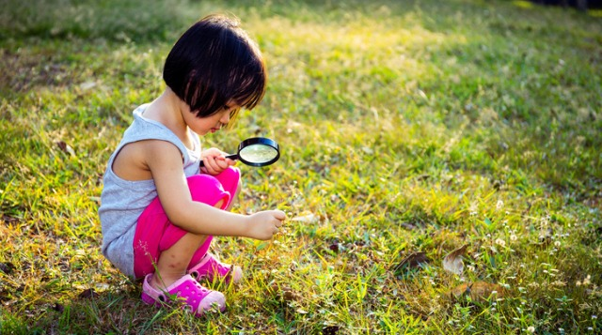
1. To See...

Slide 9
2. To Hear...

Slide 10
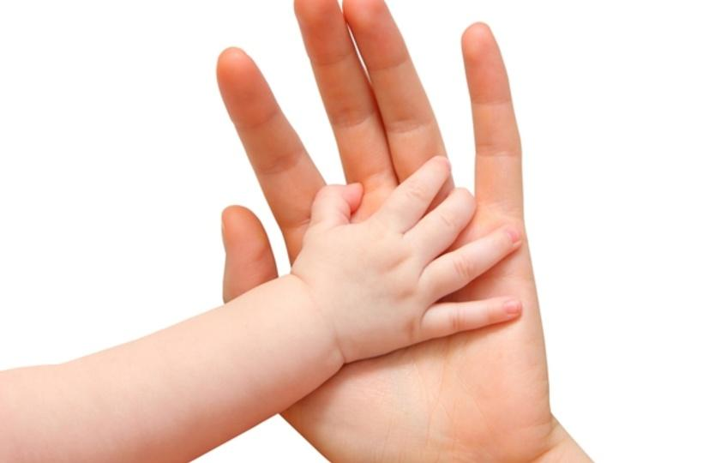
3. To Touch...

Slide 11
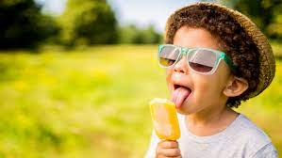
4. To Taste...

Slide 12
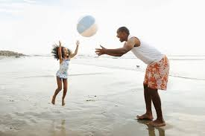
5. To Feel...

Slide 13
6. To Laugh...

Slide 14
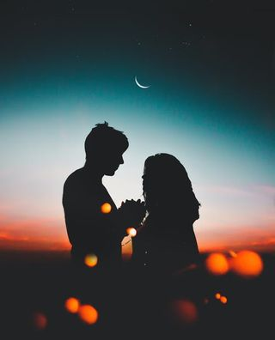
7. And to Love."

Slide 15
The room was so quiet you could have heard a pin drop. The things we overlook as simple and ordinary and that we take for granted are truly wondrous!

Slide 16
A gentle reminder :

Slide 17
That the most precious things in life cannot be built by hand or bought by man. Don't be too busy to pass this along.

